Slide 1

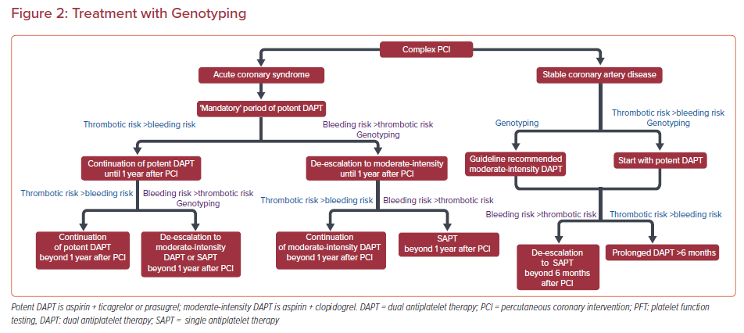
Moulias A, Papageorgiou A, Alexopoulos D
Treatment with Genotyping
Citation: US Cardiology Review 2021;15:e14.
https://doi.org/10.15420/usc.2020.33

