Slide 1
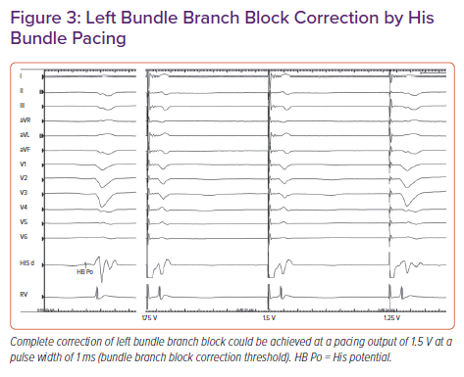
Ponnusamy SS, Vijayaraman P
Left Bundle Branch Block Correction by His Bundle Pacing
Citation: Cardiac Failure Review 2021;7:e13.
https://doi.org/10.15420/cfr.2021.04

