Slide 1
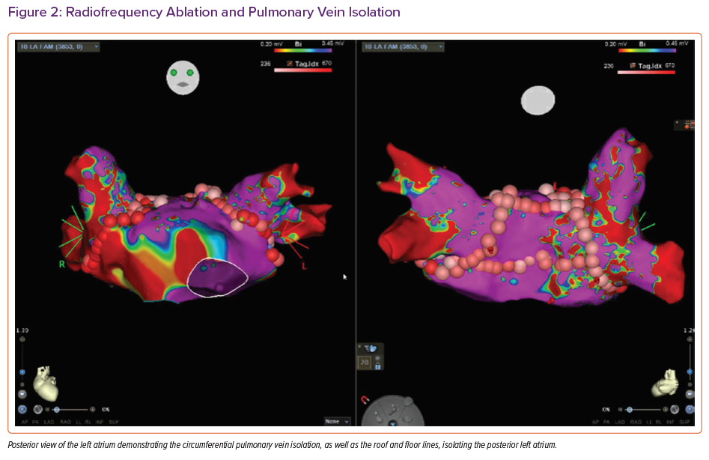
Rali AS, Weingarten A, Sandhaus E, Gupta R, Rollins AT, Bichell D, Do N, Brinkley DM, Schlendorf KH, Freno D, Balsara K, Menachem JN
Radiofrequency Ablation and Pulmonary Vein Isolation
Citation: Cardiac Failure Review 2021;7:e14.
https://doi.org/10.15420/cfr.2021.09

