Slide 1
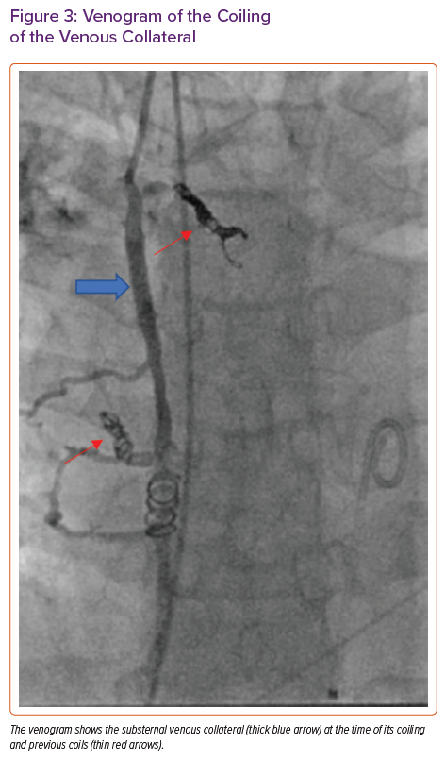
Rali AS, Weingarten A, Sandhaus E, Gupta R, Rollins AT, Bichell D, Do N, Brinkley DM, Schlendorf KH, Freno D, Balsara K, Menachem JN
Venogram of the Coiling of the Venous Collateral
Citation: Cardiac Failure Review 2021;7:e14.
https://doi.org/10.15420/cfr.2021.09

