Slide 1
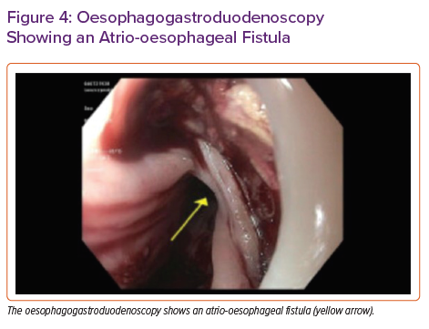
Rali AS, Weingarten A, Sandhaus E, Gupta R, Rollins AT, Bichell D, Do N, Brinkley DM, Schlendorf KH, Freno D, Balsara K, Menachem JN
Oesophagogastroduodenoscopy Showing an Atrio-oesophageal Fistula
Citation: Cardiac Failure Review 2021;7:e14.
https://doi.org/10.15420/cfr.2021.09

