Slide 1
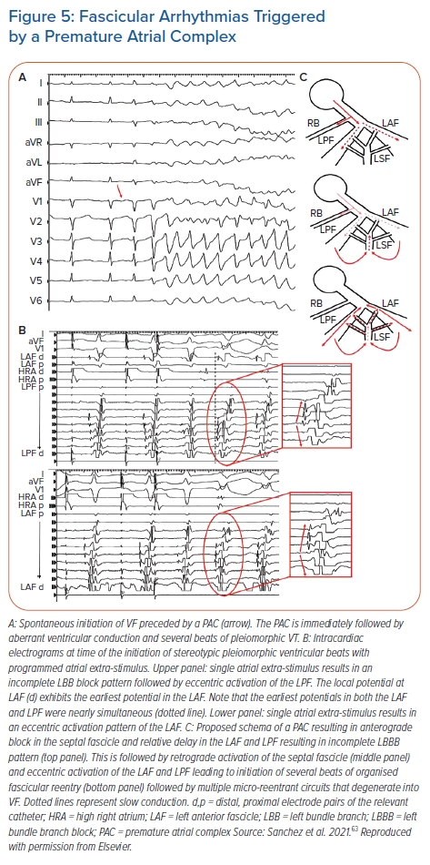
Sung RK, Boyden PA, Higuchi S, Scheinman M
Fascicular Arrhythmias Triggered by a Premature Atrial Complex
Citation: Arrhythmia & Electrophysiology Review 2021;10(3):190–7.
https://doi.org/10.15420/aer.2021.22

