Slide 1
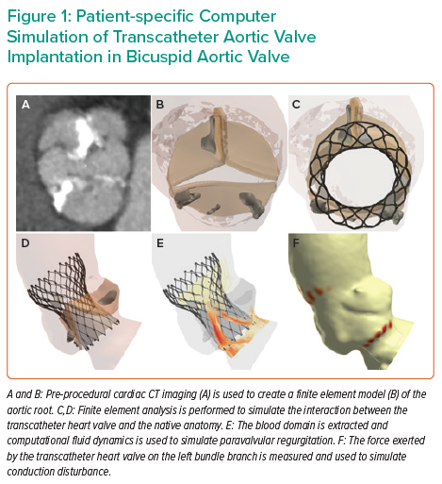
Dowling C, Gooley R, McCormick L, Firoozi S, Brecker SJ
Patient-specific Computer Simulation of Transcatheter Aortic Valve Implantation in Bicuspid Aortic Valve
Citation: Interventional Cardiology 2021;16:e26.
https://doi.org/10.15420/icr.2021.09

