Slide 1
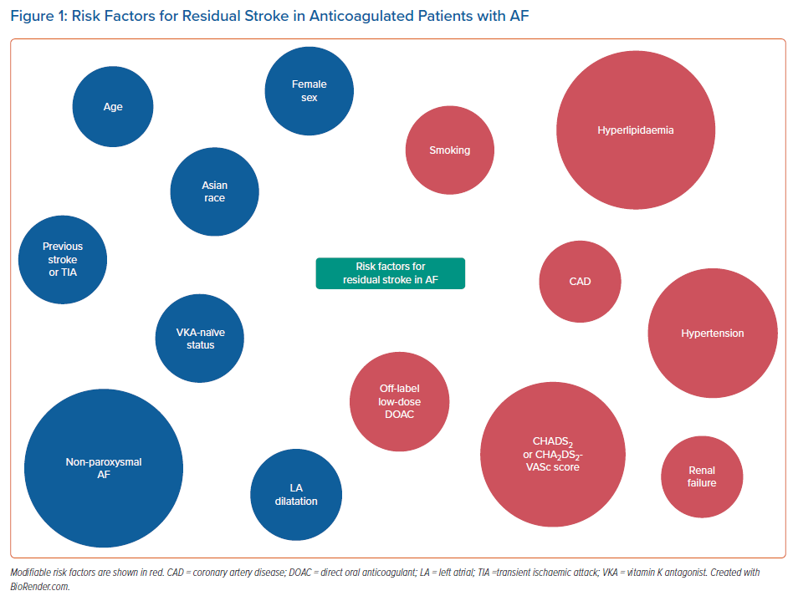
Ding WY
Risk Factors for Residual Stroke in Anticoagulated Patients with AF
Citation: Arrhythmia & Electrophysiology Review 2021;10(3):147–53.
https://doi.org/10.15420/aer.2021.34

