Slide 1
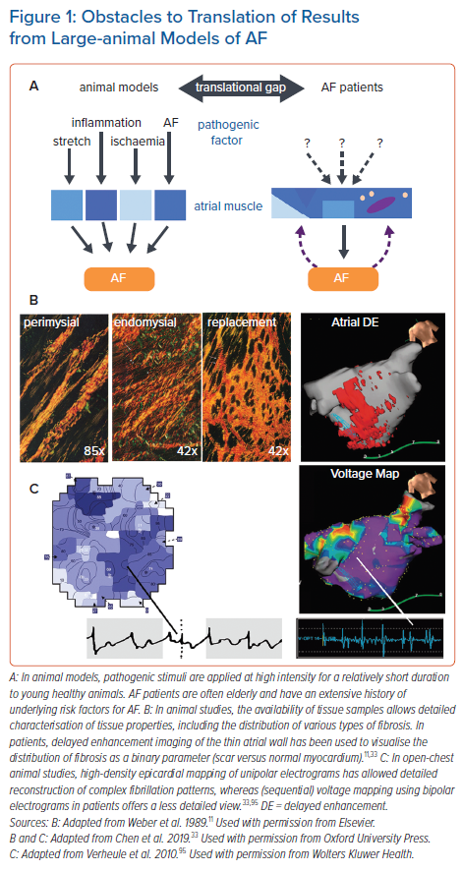
Linz D, Verheule S, Isaacs A, Schotten U
Obstacles to Translation of Results from Large-animal Models of AF
Citation: Arrhythmia & Electrophysiology Review 2021;10(3):132–9.
https://doi.org/10.15420/aer.2020.51

