Slide 1
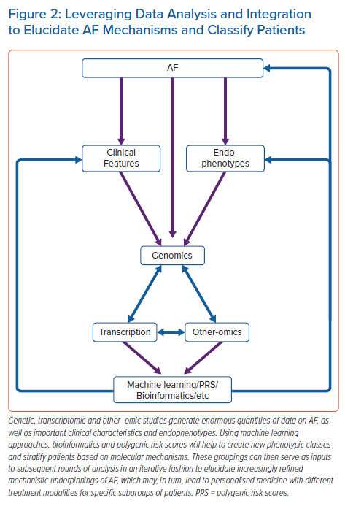
Linz D, Verheule S, Isaacs A, Schotten U
Leveraging Data Analysis and Integration to Elucidate AF Mechanisms and Classify Patients
Citation: Arrhythmia & Electrophysiology Review 2021;10(3):132–9.
https://doi.org/10.15420/aer.2020.51

