Slide 1
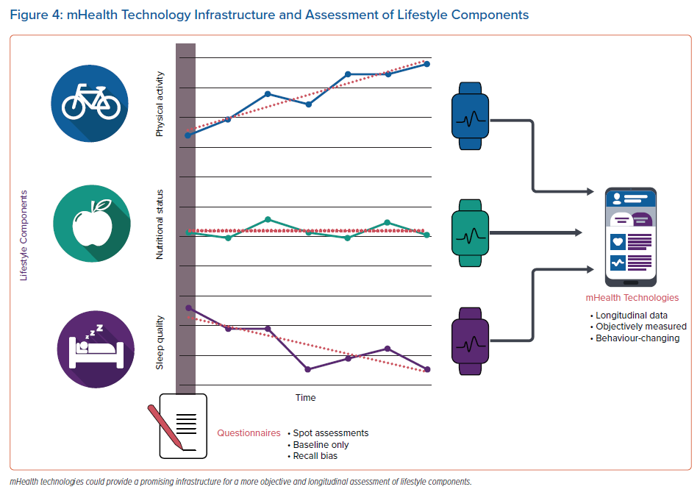
Linz D, Verheule S, Isaacs A, Schotten U
mHealth Technology Infrastructure and Assessment of Lifestyle Components
Citation: Arrhythmia & Electrophysiology Review 2021;10(3):132–9.
https://doi.org/10.15420/aer.2020.51

