Slide 1
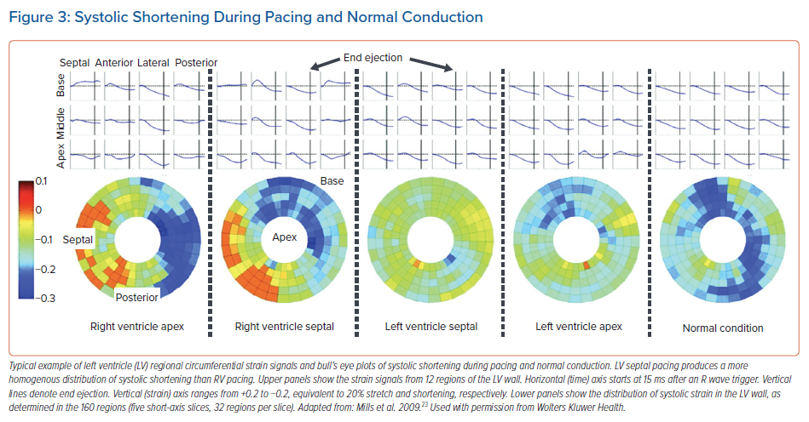
Heckman L, Luermans J, Salden F, van Stipdonk AMW, Mafi-Rad M, Prinzen F, Vernooy K
Systolic Shortening During Pacing and Normal Conduction
Citation: Arrhythmia & Electrophysiology Review 2021;10(3):165–71.
https://doi.org/10.15420/aer.2021.21

