Slide 1
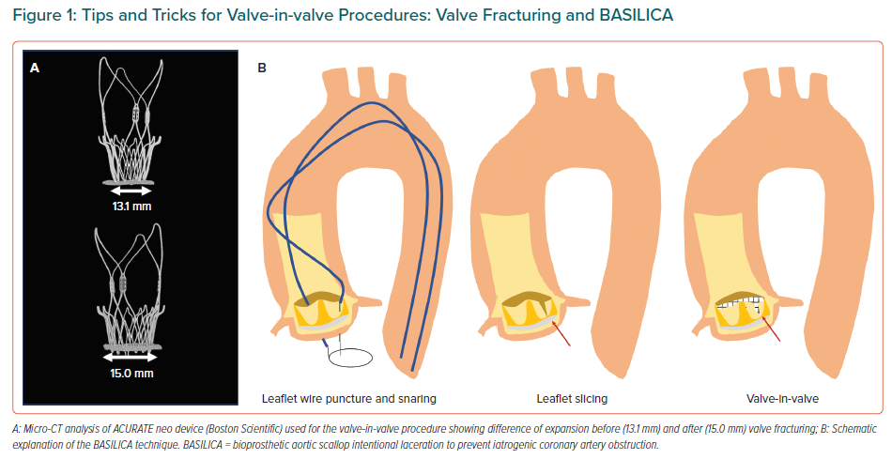
Santos-Martínez S, Amat-Santos IJ
Tips and Tricks for Valve-in-valve Procedures: Valve Fracturing and BASILICA
Citation: European Cardiology Review 2021;16:e29.
https://doi.org/10.15420/ecr.2021.12

