Slide 1
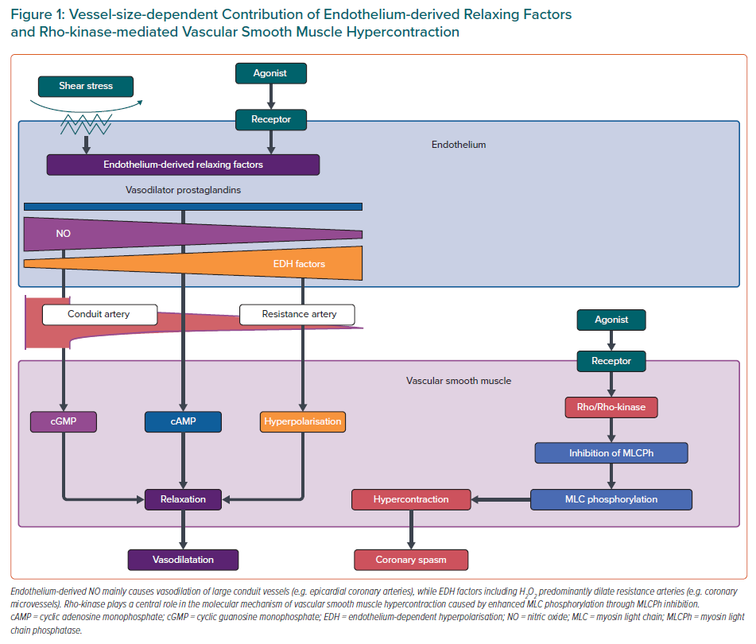
Takahashi J, Suda A, Nishimiya K, Godo S, Yasuda S, Shimokawa H
Vessel-size-dependent Contribution of Endothelium-derived Relaxing Factors and Rho-kinase-mediated Vascular Smooth Muscle Hypercontraction
Citation: European Cardiology Review 2021;16:e30.
https://doi.org/10.15420/ecr.2021.23

