Slide 1
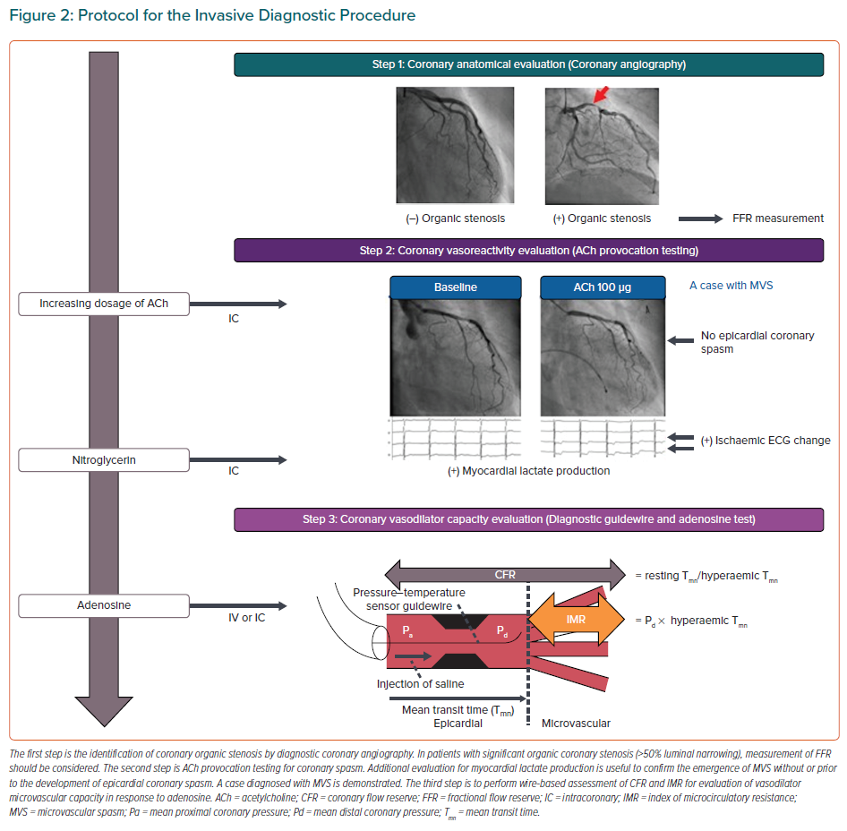
Takahashi J, Suda A, Nishimiya K, Godo S, Yasuda S, Shimokawa H
Protocol for the Invasive Diagnostic Procedure
Citation: European Cardiology Review 2021;16:e30.
https://doi.org/10.15420/ecr.2021.23

