Slide 1
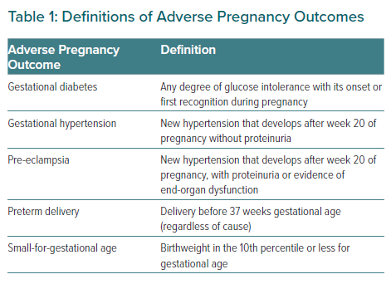
Wu P, Park K, Gulati M
Definitions of Adverse Pregnancy Outcomes
Citation: European Cardiology Review 2021;16:e31.
https://doi.org/10.15420/ecr.2021.18

