Slide 1
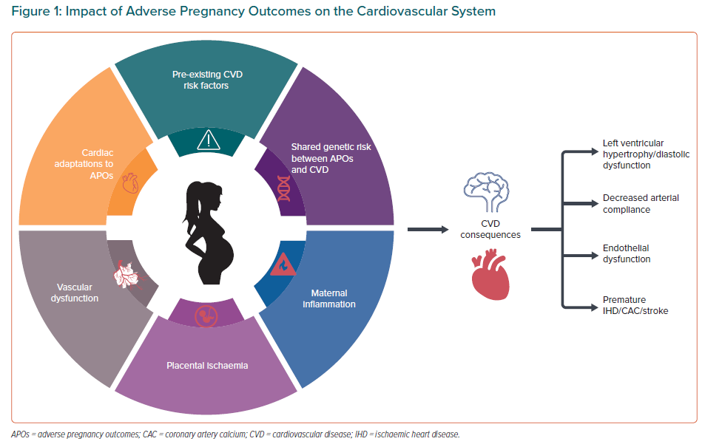
Wu P, Park K, Gulati M
Impact of Adverse Pregnancy Outcomes on the Cardiovascular System
Citation: European Cardiology Review 2021;16:e31.
https://doi.org/10.15420/ecr.2021.18

