Slide 1
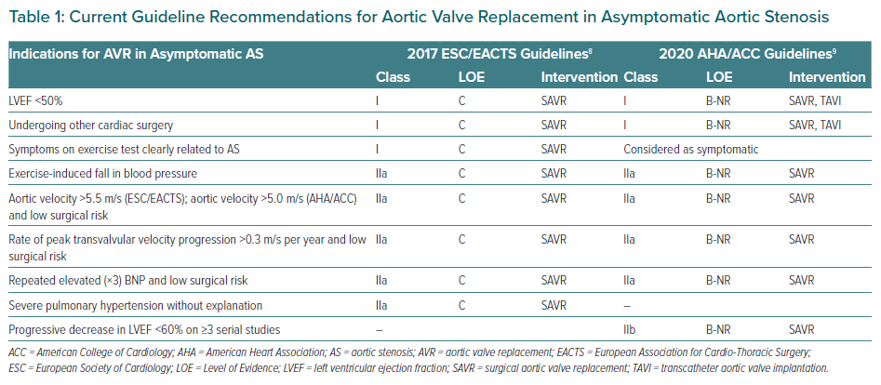
Sevilla T, Revilla-Orodea A, San Román JA
Current Guideline Recommendations for Aortic Valve Replacement in Asymptomatic Aortic Stenosis
Citation: European Cardiology Review 2021;16:e32.
https://doi.org/10.15420/ecr.2021.11

