Slide 1
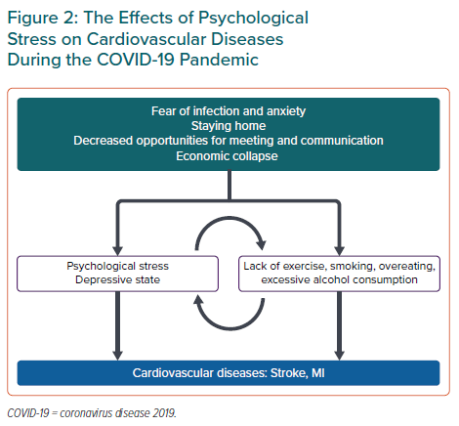
Komiyama M, Hasegawa K
The Effects of Psychological Stress on Cardiovascular Diseases During the COVID-19 Pandemic
Citation: European Cardiology Review 2021;16:e33.
https://doi.org/10.15420/ecr.2021.10

