Slide 1
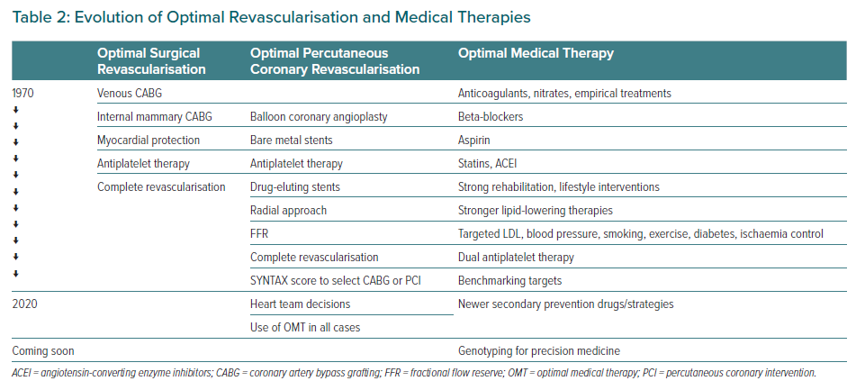
López-Sendón J, Moreno R, Tamargo J
Evolution of Optimal Revascularisation and Medical Therapies
Citation: European Cardiology Review 2021;16:e34.
https://doi.org/10.15420/ecr.2021.16

