Slide 1
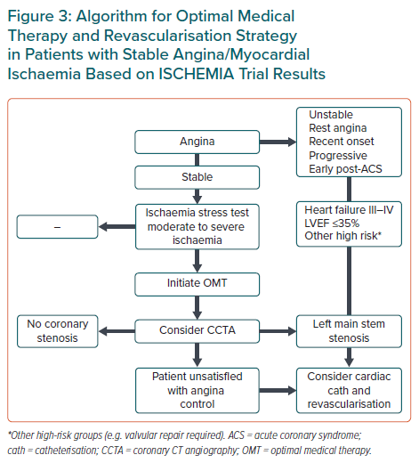
López-Sendón J, Moreno R, Tamargo J
Algorithm for Optimal Medical Therapy and Revascularisation Strategy in Patients with Stable Angina/Myocardial Ischaemia Based on ISCHEMIA Trial Results
Citation: European Cardiology Review 2021;16:e34.
https://doi.org/10.15420/ecr.2021.16

