Slide 1
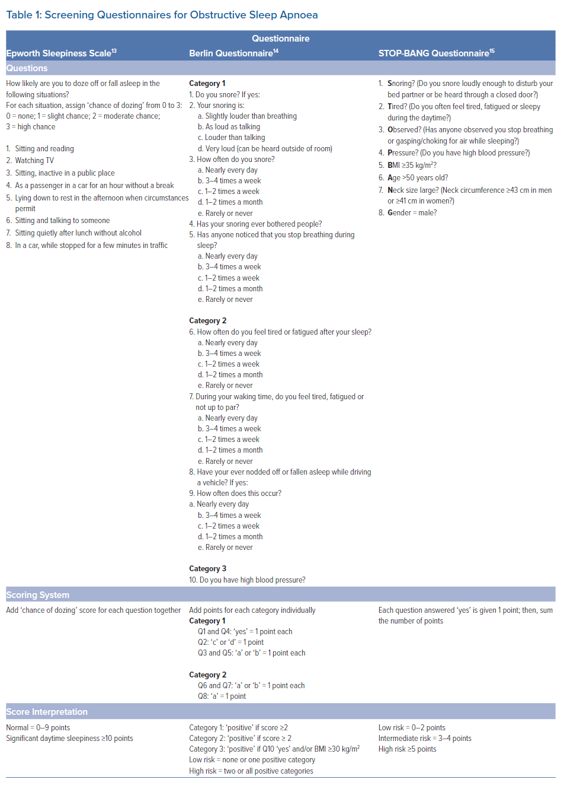
Mittal S, Golombeck D, Pimienta J
Screening Questionnaires for Obstructive Sleep Apnoea
Citation: Arrhythmia & Electrophysiology Review 2021;10(3):140–6.
https://doi.org/10.15420/aer.2021.05

