Slide 1
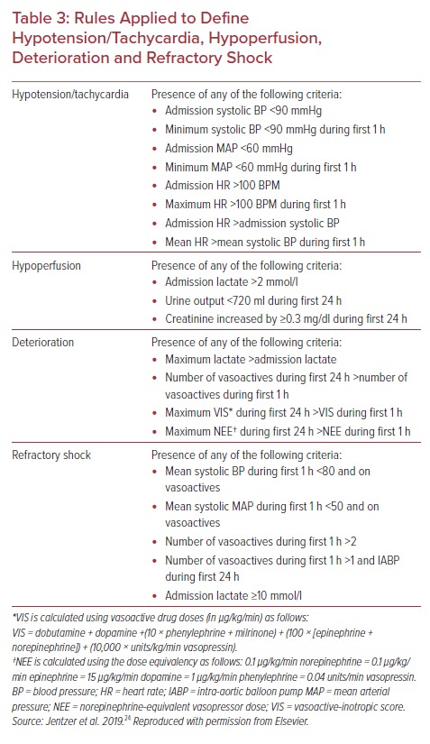
Long A, Yehya A, Stelling K, Baran DA
Rules Applied to Define Hypotension/Tachycardia, Hypoperfusion, Deterioration and Refractory Shock
Citation: US Cardiology Review 2021;15:e15.
https://doi.org/10.15420/usc.2021.09

