Slide 1
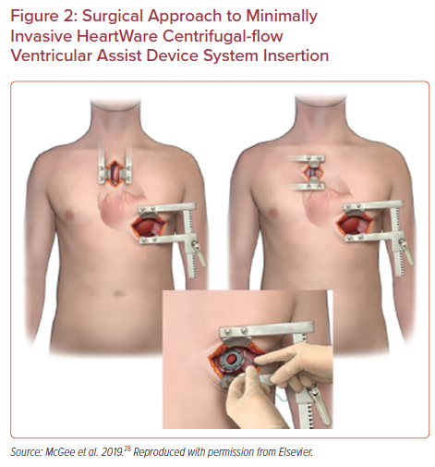
Cain MT, Firstenberg MS, Cleveland Jr JC
Surgical Approach to Minimally Invasive HeartWare Centrifugal-flow Ventricular Assist Device System Insertion
Citation: US Cardiology Review 2021;15:e16.
https://doi.org/10.15420/usc.2021.11

