Slide 1
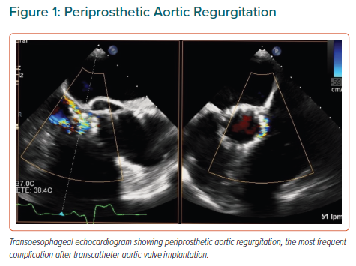
Martin M, Cuevas J, Cigarrán H, Calvo J, Morís C
Periprosthetic Aortic Regurgitation
Citation: European Cardiology Review 2021;16:e35.
https://doi.org/10.15420/ecr.2021.09

