Slide 1
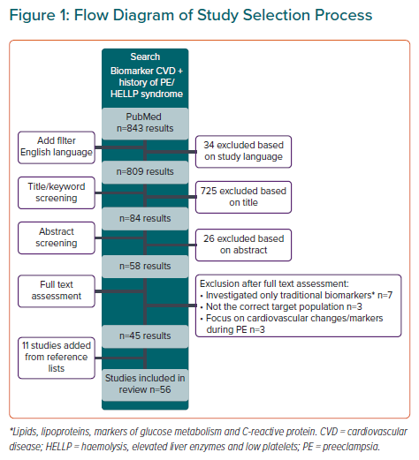
Bovee EM, Gulati M, Maas AH
Flow Diagram of Study Selection Process
Citation: European Cardiology Review 2021;16:e36.
https://doi.org/10.15420/ecr.2021.21

