Slide 1
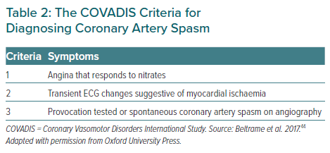
van der Meer RE, Maas AH
The COVADIS Criteria for Diagnosing Coronary Artery Spasm
Citation: European Cardiology Review 2021;16:e37.
https://doi.org/10.15420/ecr.2021.20

