Slide 1
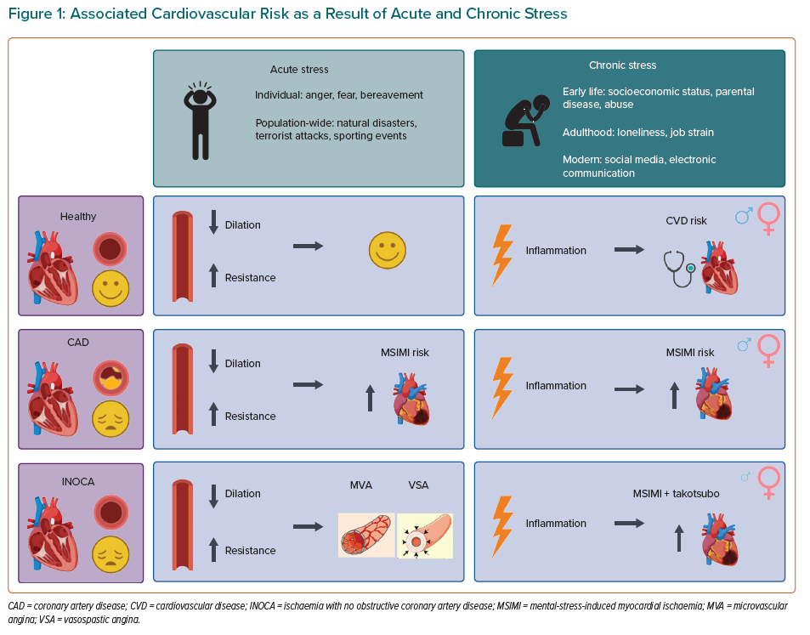
van der Meer RE, Maas AH
Associated Cardiovascular Risk as a Result of Acute and Chronic Stress
Citation: European Cardiology Review 2021;16:e37.
https://doi.org/10.15420/ecr.2021.20

