Slide 1
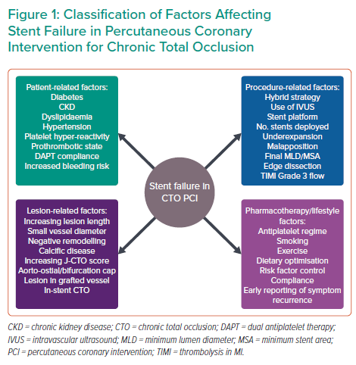
Mahadevan K, Cosgrove C, Strange J
Classification of Factors Affecting Stent Failure in Percutaneous Coronary Intervention for Chronic Total Occlusion
Citation: Interventional Cardiology 2021;16:e27.
https://doi.org/10.15420/icr.2021.03

