Slide 1
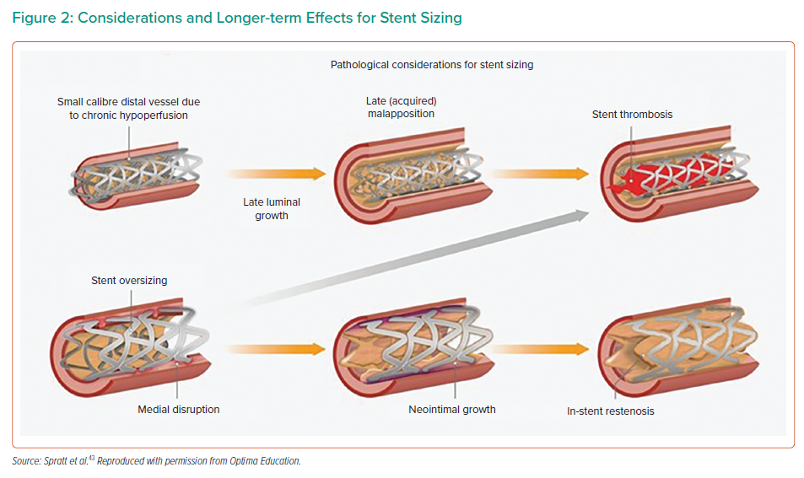
Mahadevan K, Cosgrove C, Strange J
Considerations and Longer-term Effects for Stent Sizing
Citation: Interventional Cardiology 2021;16:e27.
https://doi.org/10.15420/icr.2021.03

