Slide 1
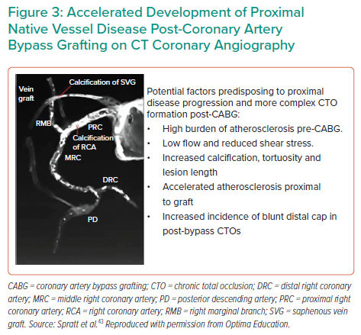
Mahadevan K, Cosgrove C, Strange J
Accelerated Development of Proximal Native Vessel Disease Post-Coronary Artery Bypass Grafting on CT Coronary Angiography
Citation: Interventional Cardiology 2021;16:e27.
https://doi.org/10.15420/icr.2021.03

