Slide 1
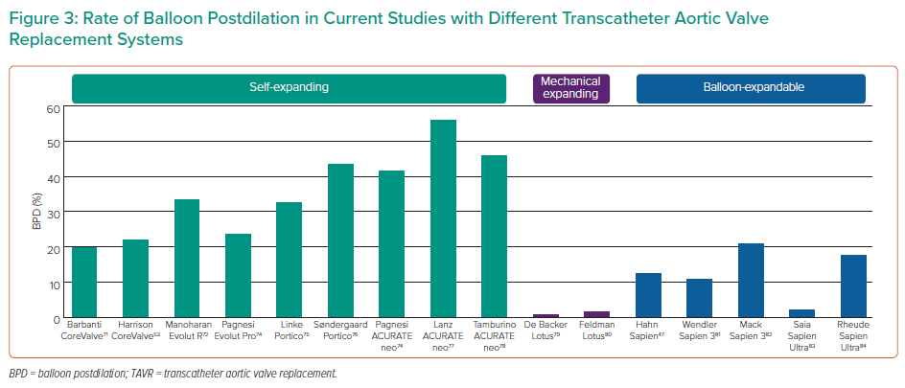
McInerney A, Vera-Urquiza R, Tirado-Conte G, Marroquin L, Jimenez-Quevedo P, Nuñez-Gil I, Pozo E, Gonzalo N, de Agustín JA, Escaned J, Fernández-Ortiz A, Macaya C, Nombela-Franco L
Rate of Balloon Postdilation in Current Studies with Different Transcatheter Aortic Valve Replacement Systems
Citation: Interventional Cardiology 2021;16:e28.
https://doi.org/10.15420/icr.2020.35

