Slide 1
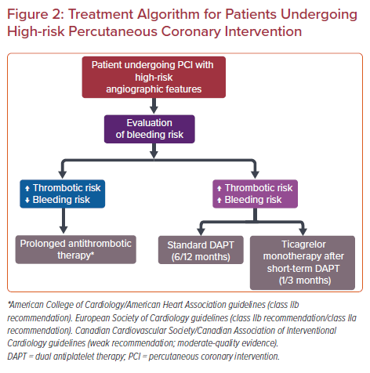
Benetou DR, Varlamos C, Pappas C, Kolokathis F, Alexopoulos D
Treatment Algorithm for Patients Undergoing High-risk Percutaneous Coronary Intervention
Citation: US Cardiology Review 2021;15:e17.
https://doi.org/10.15420/usc.2020.30

