Slide 1
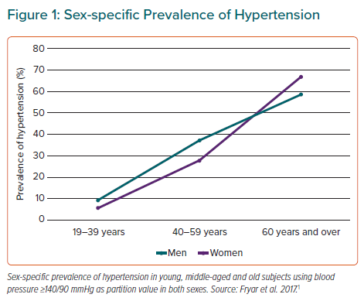
Gerdts E, de Simone G
Sex-specific Prevalence of Hypertension
Citation: European Cardiology Review 2021;16:e38.
https://doi.org/10.15420/ecr.2021.17

