Slide 1
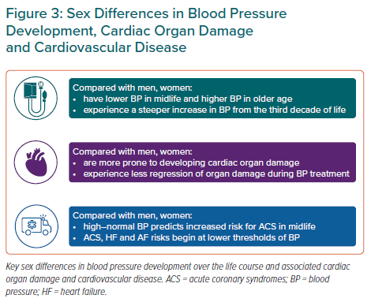
Gerdts E, de Simone G
Sex Differences in Blood Pressure Development, Cardiac Organ Damage and Cardiovascular Disease
Citation: European Cardiology Review 2021;16:e38.
https://doi.org/10.15420/ecr.2021.17

