Slide 1
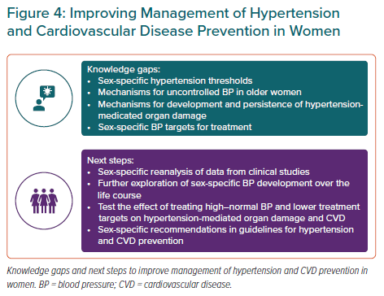
Gerdts E, de Simone G
Improving Management of Hypertension and Cardiovascular Disease Prevention in Women
Citation: European Cardiology Review 2021;16:e38.
https://doi.org/10.15420/ecr.2021.17

