Slide 1
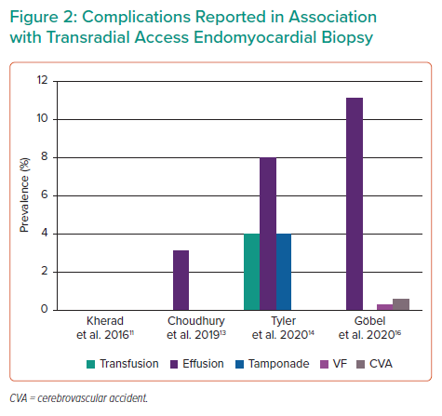
Tyler Z, Guttmann OP, Savvatis K, Jones D, O’Mahony C
Complications Reported in Association with Transradial Access Endomyocardial Biopsy
Citation: Interventional Cardiology 2021;16:e29.
https://doi.org/10.15420/icr.2021.20

