Slide 1
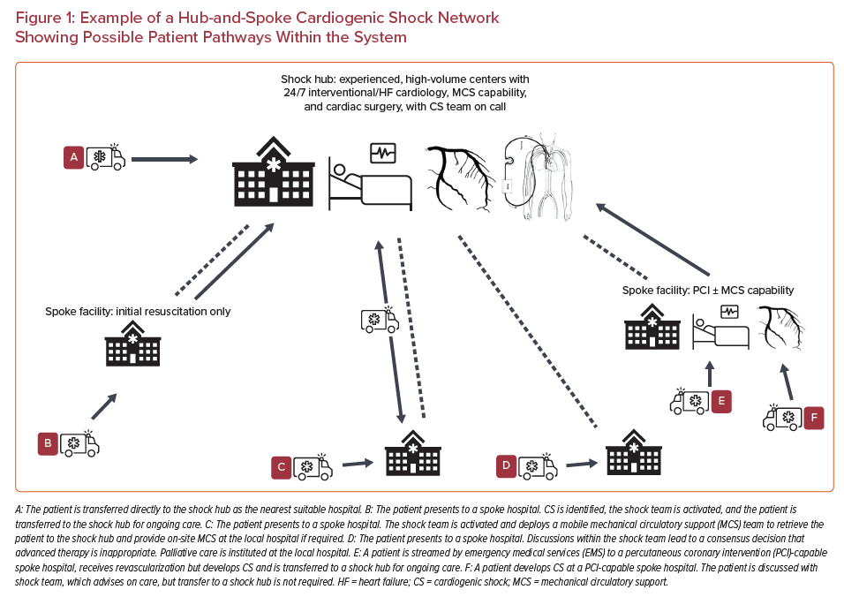
Warren AF, Rosner C, Gattani R, Truesdell AG, Proudfoot AG
Example of a Hub-and-Spoke Cardiogenic Shock Network Showing Possible Patient Pathways Within the System
Citation: US Cardiology Review 2021;15:e18.
https://doi.org/10.15420/usc.2021.10

