Slide 1
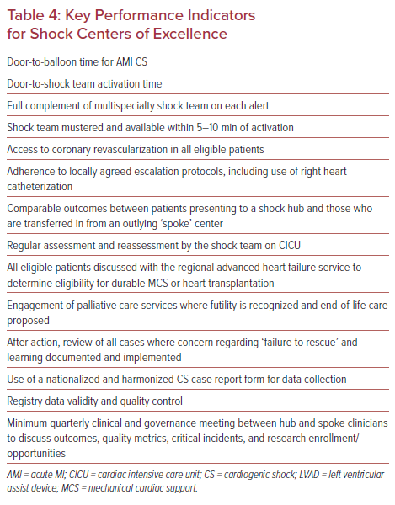
Warren AF, Rosner C, Gattani R, Truesdell AG, Proudfoot AG
Key Performance Indicators for Shock Centers of Excellence
Citation: US Cardiology Review 2021;15:e18.
https://doi.org/10.15420/usc.2021.10

