Slide 1

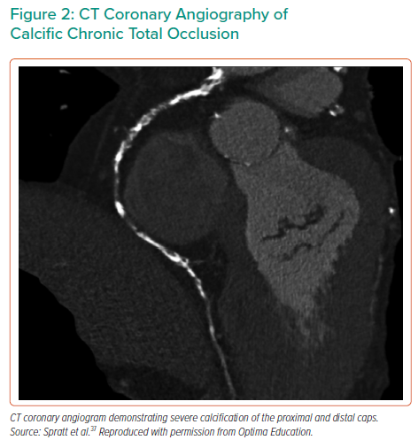
Cosgrove C, Mahadevan K, Spratt J, McEntegart MB
CT Coronary Angiography of Calcific Chronic Total Occlusion
Citation: Interventional Cardiology 2021;16:e30.
https://doi.org/10.15420/icr.2021.01

