Slide 1
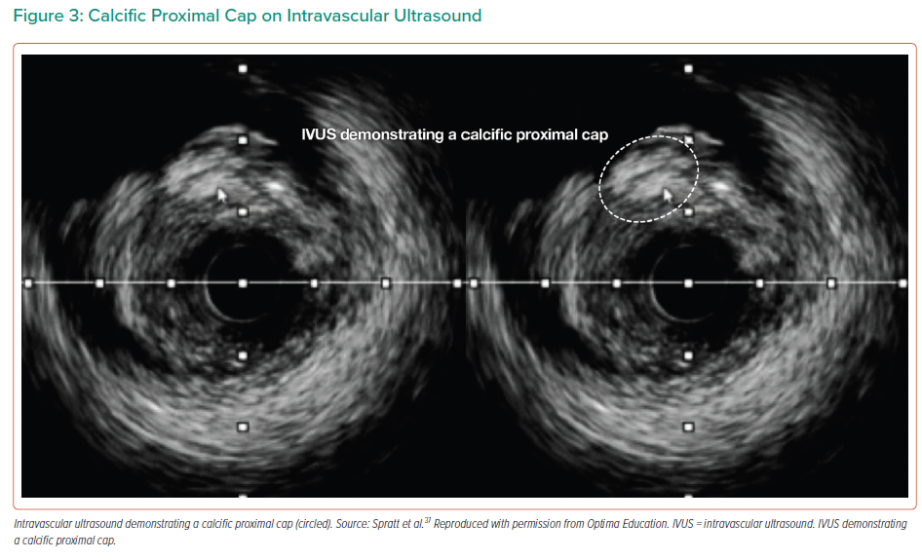
Cosgrove C, Mahadevan K, Spratt J, McEntegart MB
Calcific Proximal Cap on Intravascular Ultrasound
Citation: Interventional Cardiology 2021;16:e30.
https://doi.org/10.15420/icr.2021.01

