Slide 1
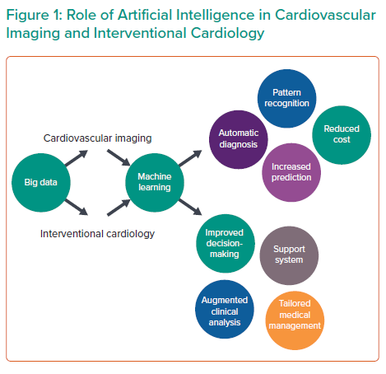
Seetharam K, Shrestha S, Sengupta PP
Role of Artificial Intelligence in Cardiovascular lmaging and Interventional Cardiology
Citation: Interventional Cardiology 2021;16:e31.
https://doi.org/10.15420/icr.2020.04

