Slide 1
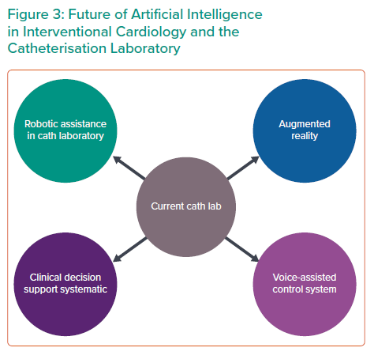
Seetharam K, Shrestha S, Sengupta PP
Future of Artificial Intelligence in Interventional Cardiology and the Catheterisation Laboratory
Citation: Interventional Cardiology 2021;16:e31.
https://doi.org/10.15420/icr.2020.04

