Slide 1
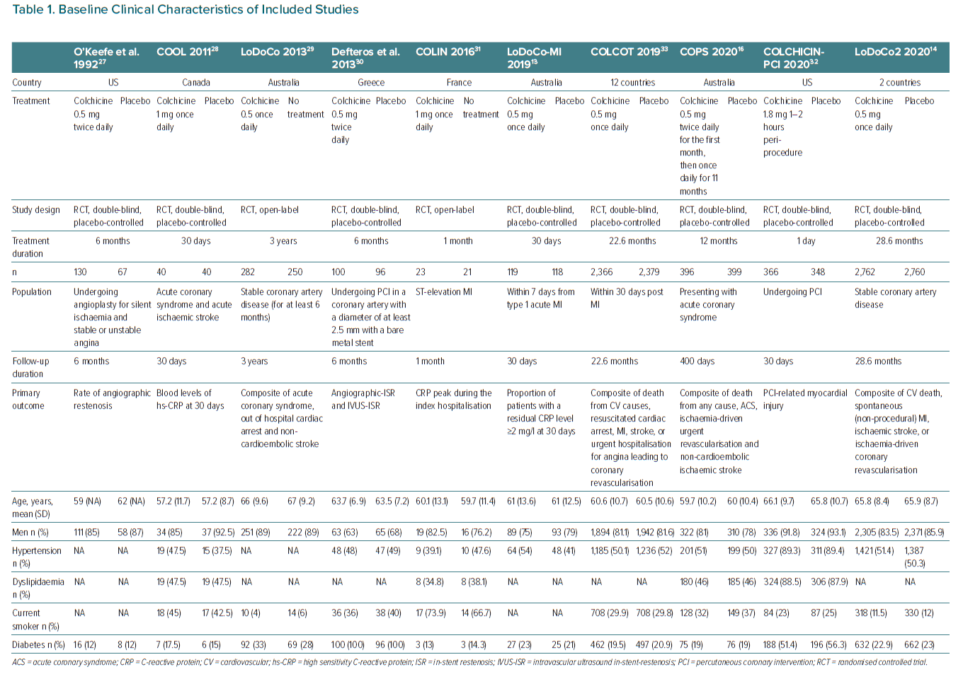
Condello F, Sturla M, Reimers B, Liccardo G, Stefanini GG, Condorelli G, Ferrante G
Baseline Clinical Characteristics of Included Studies
Citation: European Cardiology Review 2021;16:e39.
https://doi.org/10.15420/ecr.2021.31

