Slide 1
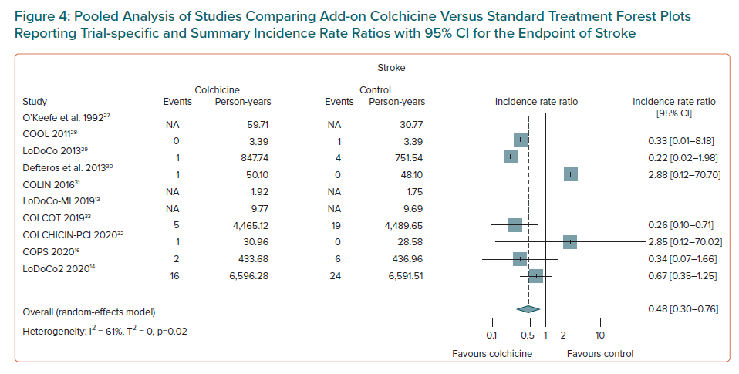
Condello F, Sturla M, Reimers B, Liccardo G, Stefanini GG, Condorelli G, Ferrante G
Pooled Analysis of Studies Comparing Add-on Colchicine Versus Standard Treatment Forest Plots Reporting Trial-specific and Summary Incidence Rate Ratios with 95% CI for the Endpoint of Stroke
Citation: European Cardiology Review 2021;16:e39.
https://doi.org/10.15420/ecr.2021.31

