Slide 1
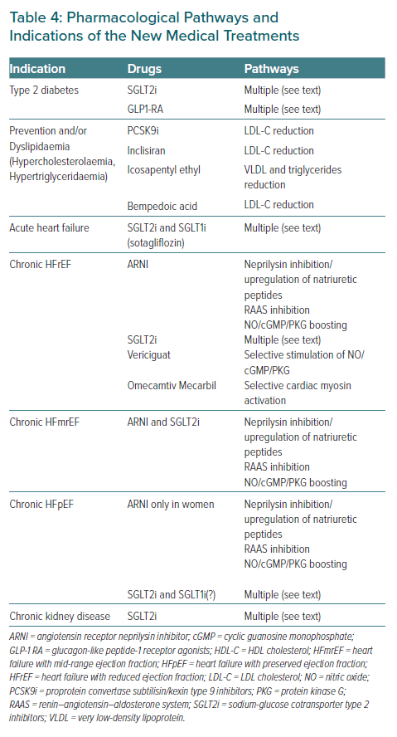
Galati G, Sabouret P, Germanova O, Bhatt DL
Pharmacological Pathways and Indications of the New Medical Treatments
Citation: European Cardiology Review 2021;16:e40.
https://doi.org/10.15420/ecr.2021.22

