Slide 1
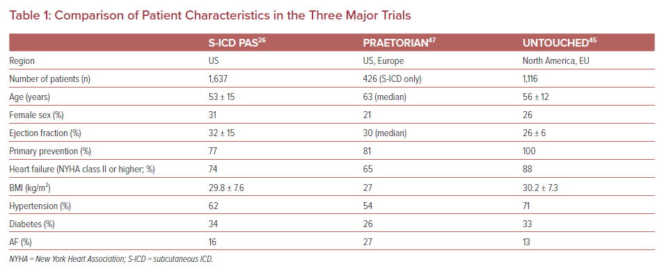
John LA, Karimianpour A, Gold MR
Comparison of Patient Characteristics in the Three Major Trials
Citation: US Cardiology Review 2021;15:e19.
https://doi.org/10.15420/usc.2021.01

