Slide 1
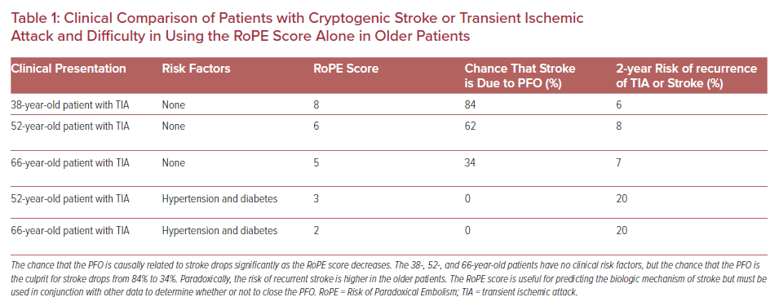
Vazquez-Sosa C, Clegg SD, Blankenship JC
Clinical Comparison of Patients with Cryptogenic Stroke or Transient Ischemic Attack and Difficulty in Using the RoPE Score Alone in Older Patients
Citation: US Cardiology Review 2021;15:e20.
https://doi.org/10.15420/usc.2020.40

