Slide 1

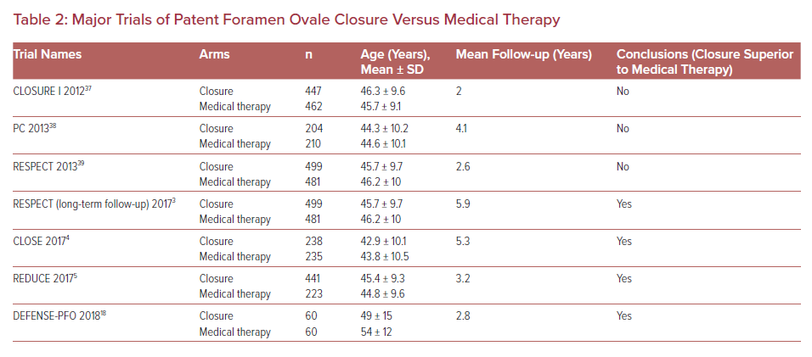
Vazquez-Sosa C, Clegg SD, Blankenship JC
Major Trials of Patent Foramen Ovale Closure Versus Medical Therapy
Citation: US Cardiology Review 2021;15:e20.
https://doi.org/10.15420/usc.2020.40

