Slide 1
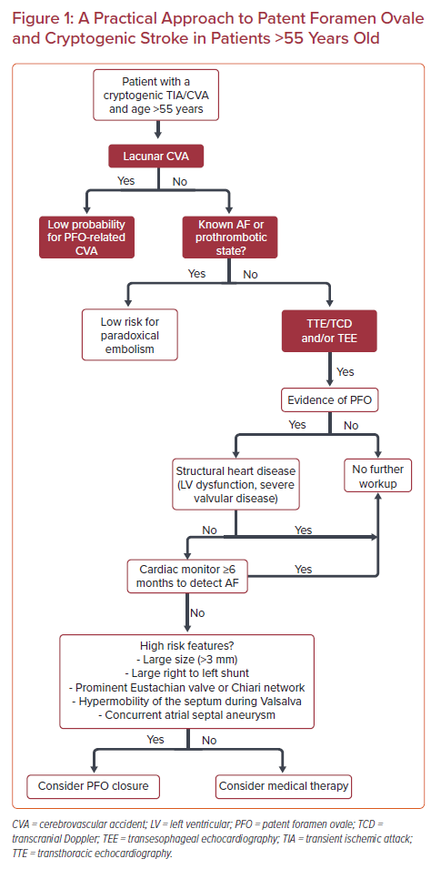
Vazquez-Sosa C, Clegg SD, Blankenship JC
A Practical Approach to Patent Foramen Ovale and Cryptogenic Stroke in Patients >55 Years Old
Citation: US Cardiology Review 2021;15:e20.
https://doi.org/10.15420/usc.2020.40

